Slide 1
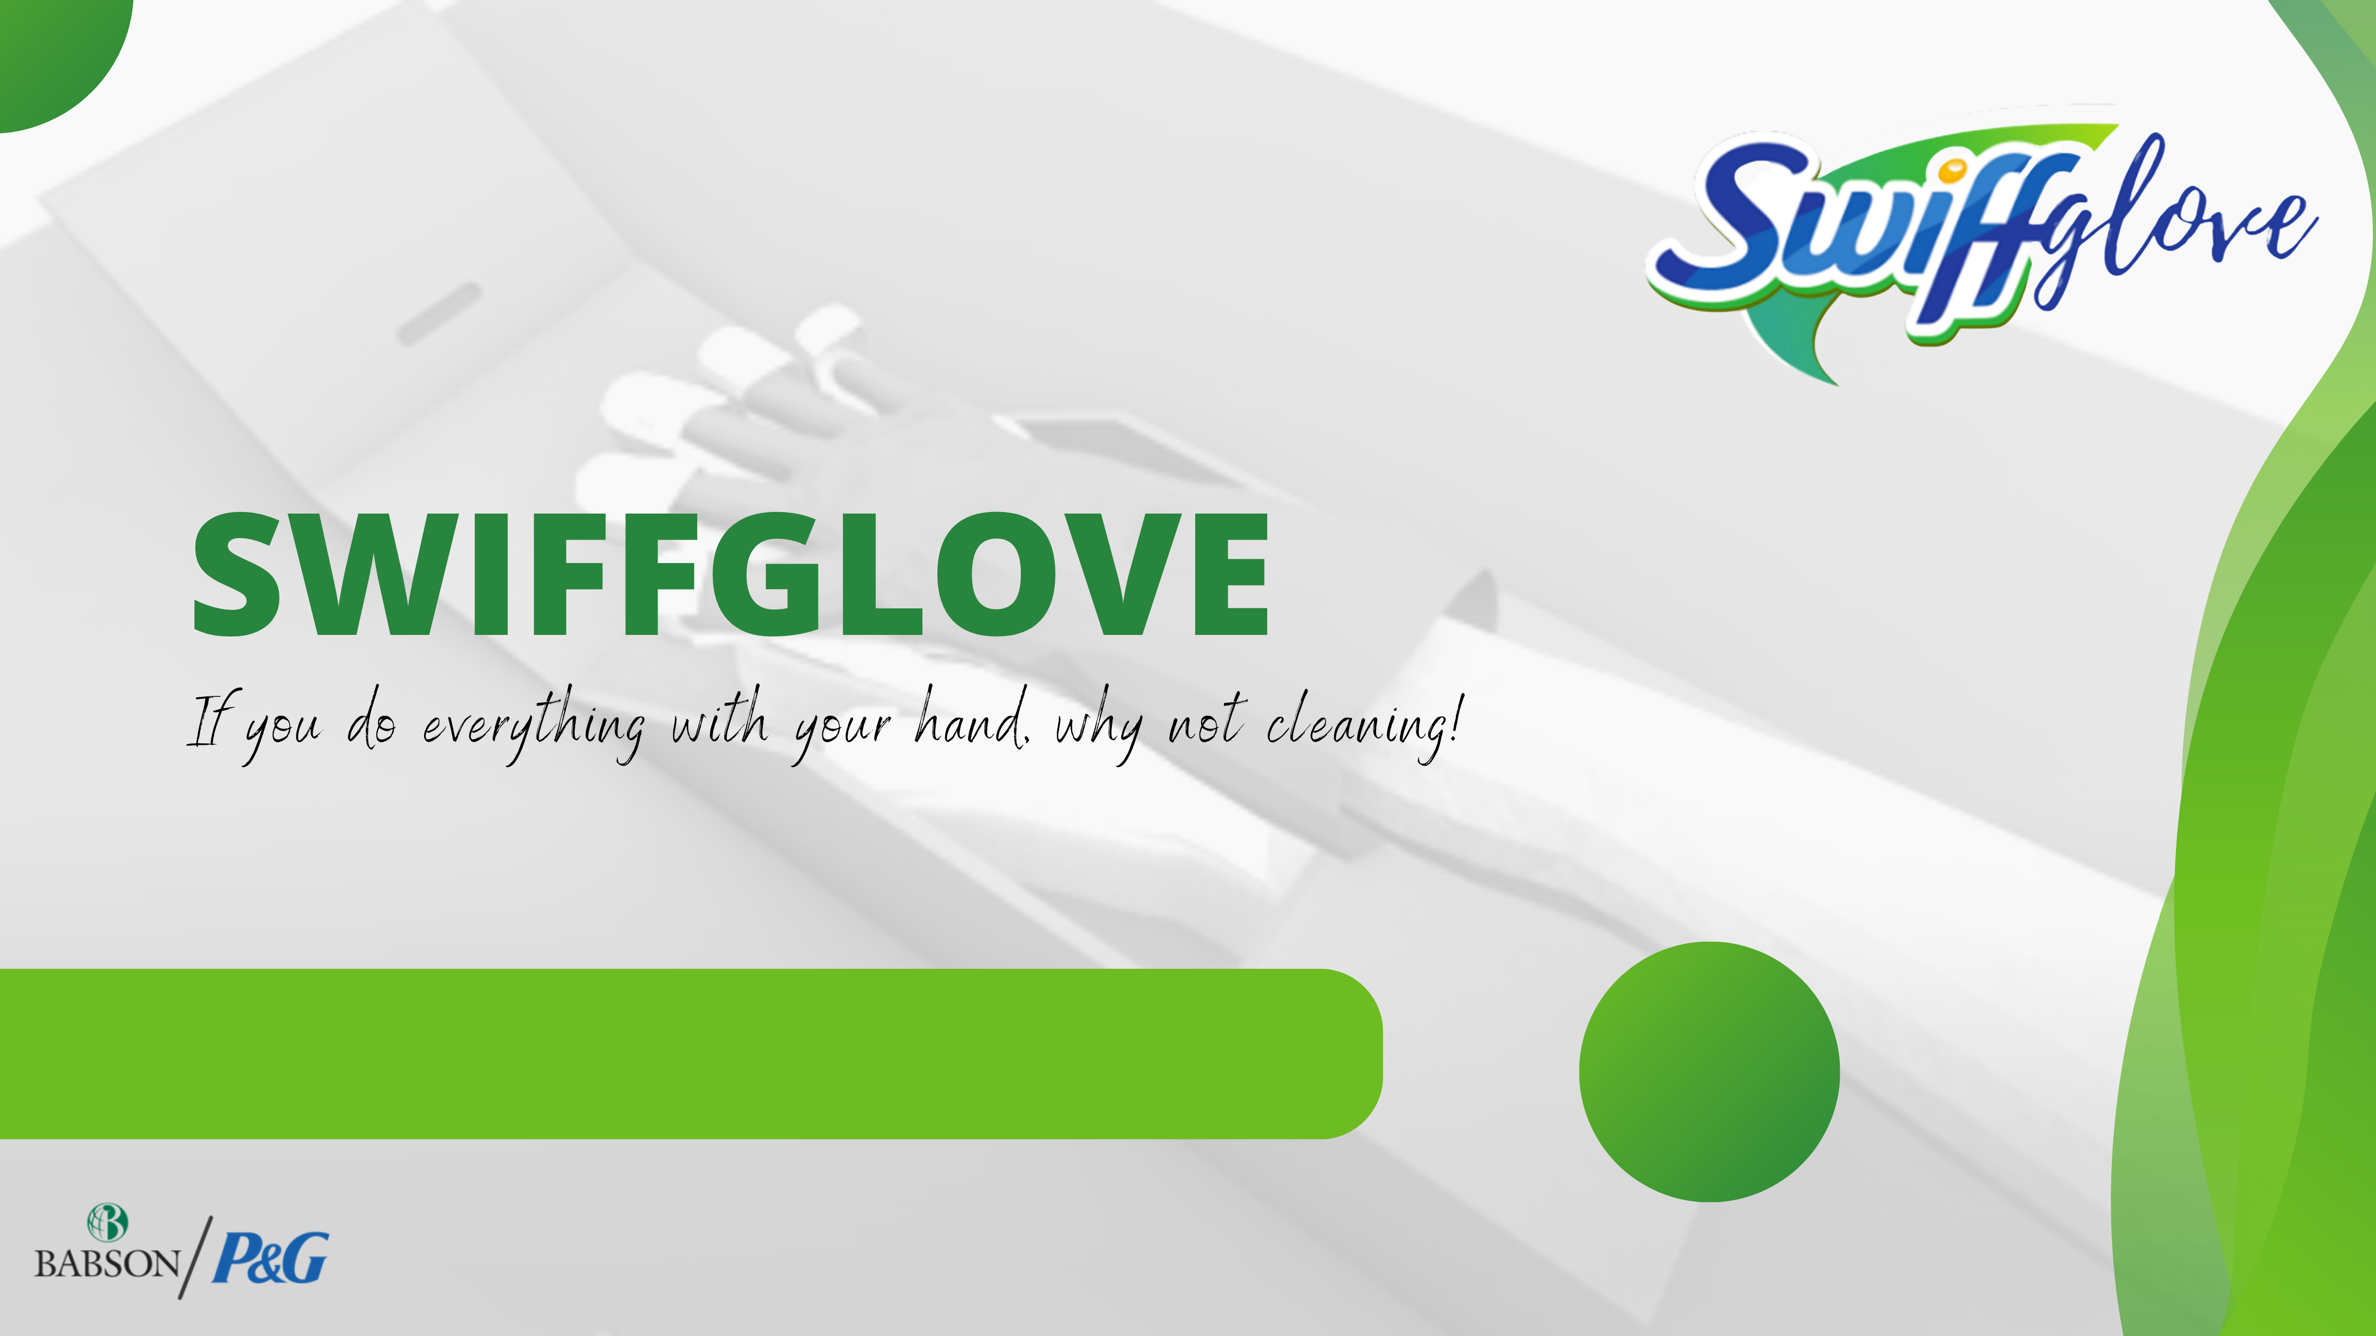
Saikeerthana Bobba, Surya Jayakumar, Melany Vargas Salas, Vishnu Kariyattu, Abraham Guerrero
Group
18
Notes:
Clean difficult surfaces like your kitchen cabinets and you Will see the difference!

Slide 2

THE PRODUCT 1
BUYING PROCESS, SEGMENTATION AND TARGETING 2
POSITIONING 3
GO-TO-MARKET PLAN (MARKETING MIX 4PS) 4
BUSINESS PROCESS FLOW 5
DEMAND AND CAPACITY UTILIZATION PROJECTIONS 6
UNSDG SUSTAINABILITY PRODUCT GOAL 7
FINANCIALS SWIFFGLOVE 8
RISK PROFILE 9
SENSITIVITY ANALYSIS AND CONTINGENCY PLANS 10
MARKETING
OPERATIONS
FINANCE
BA

Slide 3


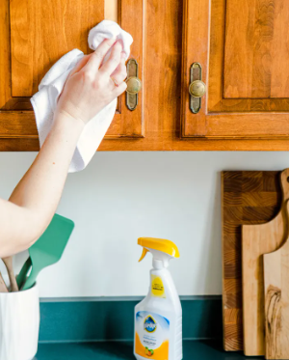
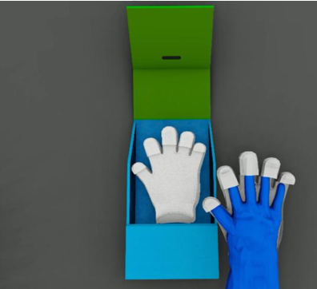
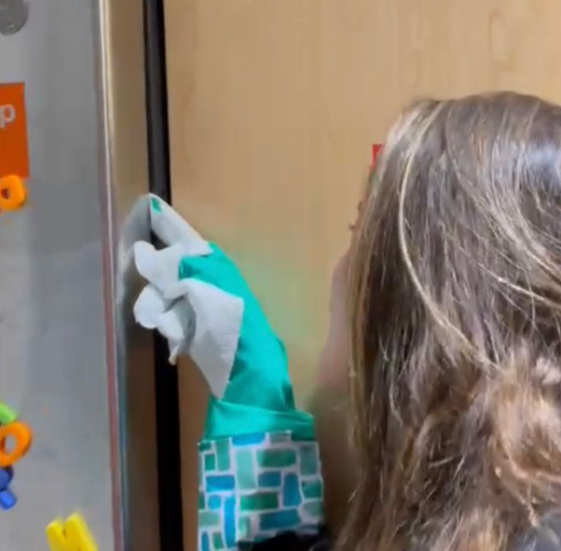

Slide 4

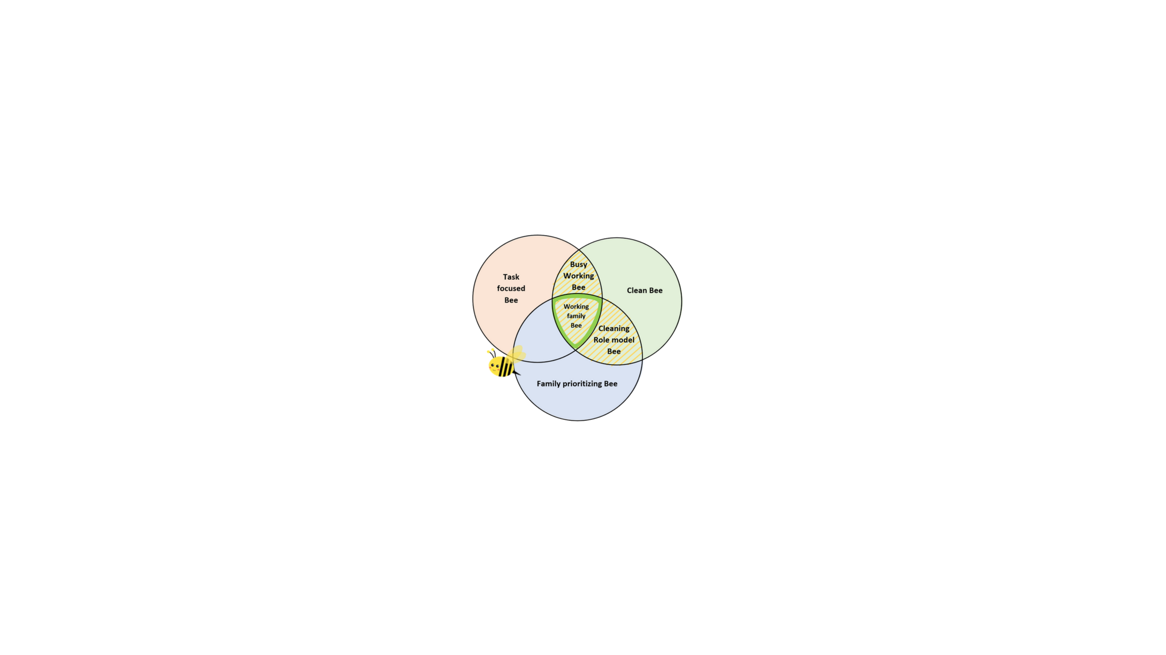




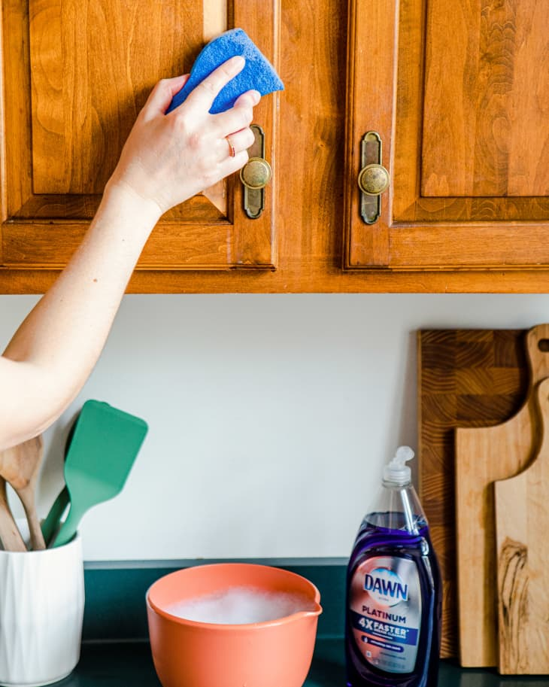

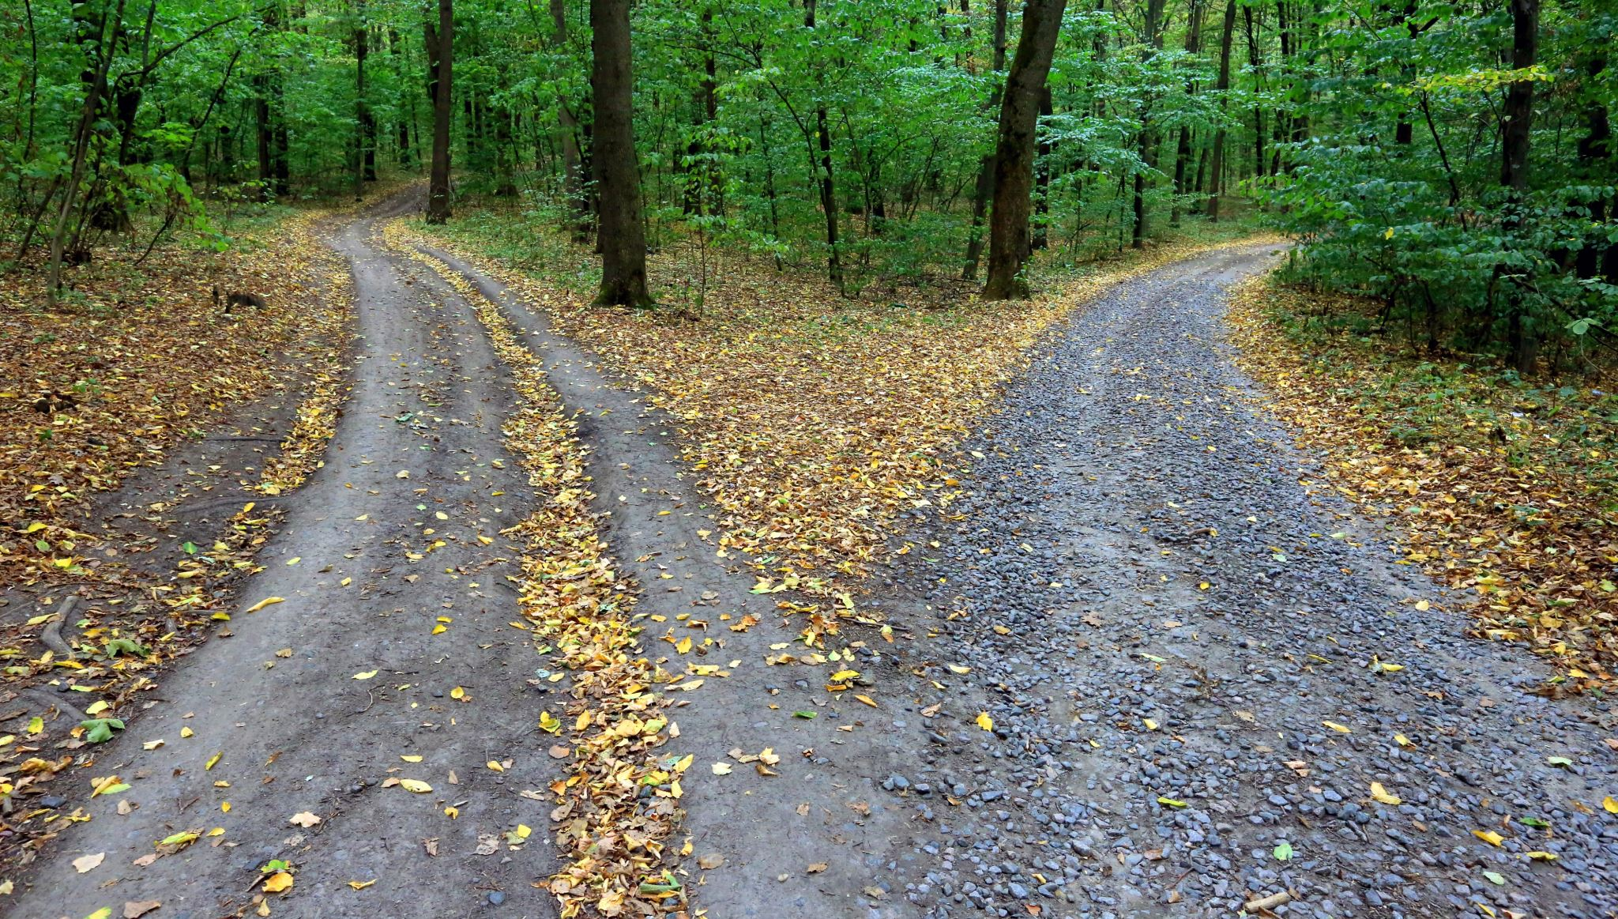




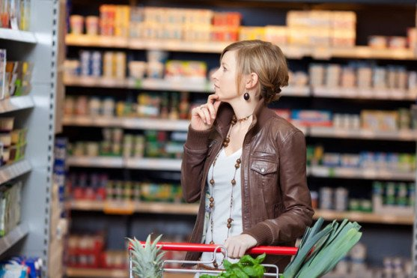
Problem Recognition
Information Search
Evaluation of Alternatives
Purchase
decision
Repurchase
Use of Product
In (Millions $) | 2023 | 2024 | 2025 | 2026 | 2027
Tot Market | 5,580 | 5,943 | 6,329 | 6,740 | 7,178
Revenue | 0.41 | 52.5 | 78.7 | 105 | 131.2
Market share | 0.01% | 0.9% | 1.2% | 1.6% | 1.8%
Notes:
SEGMENTATION: talk about each segment and differences between them
mention mkt strategies to find them and target them
TARGET MARKET: Describe the one in the middle
market size and market share
Uncertainaties: Not sure of maret share of target customer, and mixing two industries and this gets a smaller market share with a differenciated product (not massive like paper towel)
BUYING PROCESS: Key steps you need to influence to convince people to buy me instead of competitor
Mention communication strategy to avoid competitors to sell to my customer

Slide 5





For professionals with families, who have little time for cleaning
The SwiffGlove is a solution for cleaning oddly shaped surfaces such as kitchen cabinets, it is quick and easy to use and protects you from harmful chemicals and bacteria.
Our glove uses “Stick On” technology to easily attach and peel off the wipes. The glove is the barrier protecting your skin and its shape promotes intuitive use.
Cleans
oddly shaped surfaces
Differentiation
“Stick on Technology”
“Trap and Lock” (Electrostatic Technology)
Hand-Shaped wipes
Does not Provide Safety
Industry
Paper Towels
Wet and Dry cleaning wipes
Provides Safety
Advantage from competitors
Patent seeking strategy
Swiffer brand
Does not clean
oddly shaped surfaces
Notes:
Target segment
Frame of reference
Point of differentiation
Reason to believe

Slide 6

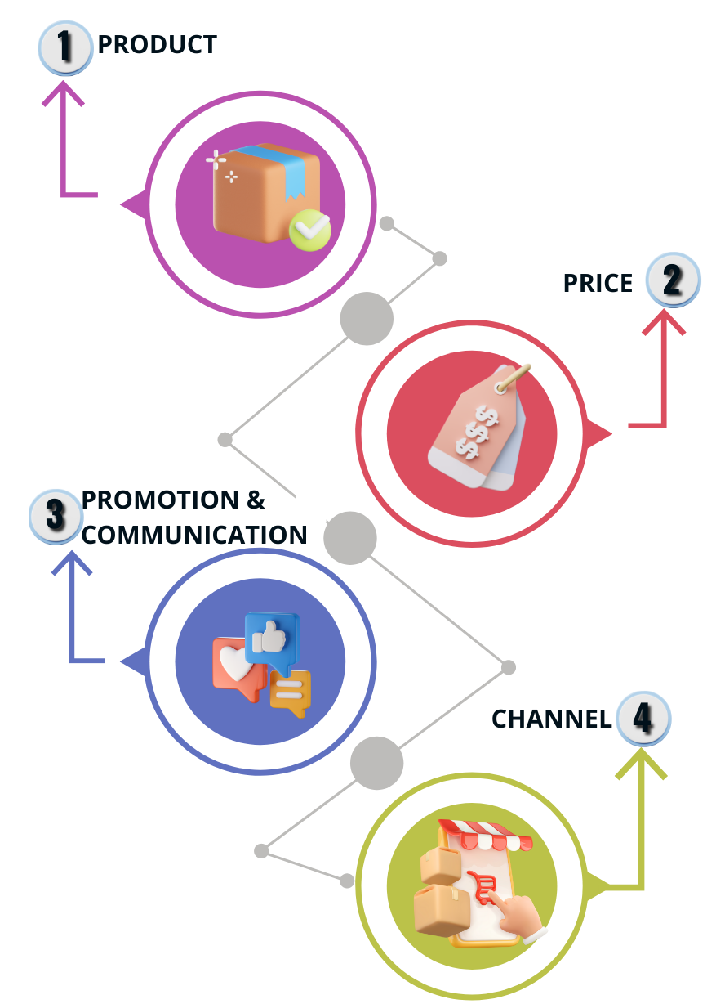





Objectives
Swiffer extension
Linked to brand
Awareness
Education
First entry
Retail price:
Main SKUS (1 per size/side)
$ 10 x24-unit wipes
$ 5 Glove
$ 15 Initial pack Glove + 24 wipes
Pack of entry:
$ 10 Glove + 10 wipes
Frequency:
1 month Wipes x24 units
3 months 1 Glove
Point of pain and solution communication
Testimonials & WOF
“In Store demo”
Swiffer linked promotions
Additional visibility paid in stores
Advertising billboards main cities
TV and radio spots
Digital media and influencers
Media
# products bought / # of trials (retail)
# of website visits (online data)
# of clicks on paid (online data)
% brand awareness (focus groups)
# of repurchase (retailers)
Choice: Retailers
Margins: 50%
Roles: *P&G advantage relationship for negotiation *Direct contact final user “in store demo”
KPIs
Notes:
CHANNEL:
We begin in Midwest
Growth strategy: expand in retailers (Walmart Target)
PRICE: Consider to estimate customer research (willingness to pay), margins of 50% for retailers
PRODUCT: Swiffer extension for existing P&G Markets
Linked to brand as a competitive advantage

Slide 7

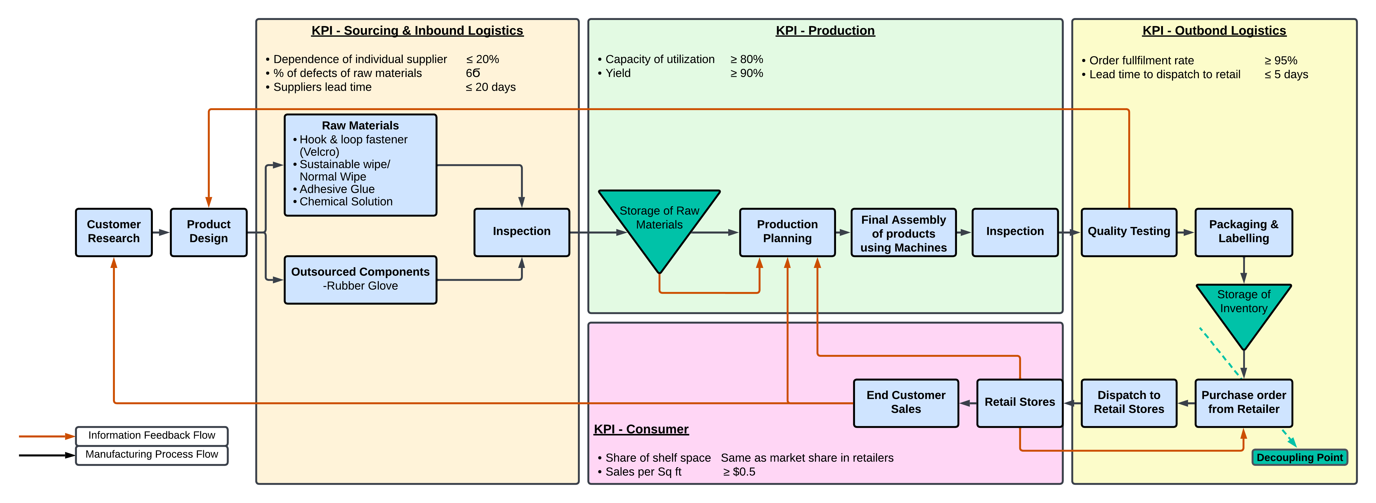

Slide 8


 | Dec-23 | Jun-24 | Aug-24 | Feb-25 | Feb-26 | Jun-26 | Aug-26 | Oct-26
Capacity Increase
New Polyester Supplier
New Bamboo Paper Supplier

Slide 9


Plastic Consumption Reduced
One glove area (in sq. cm) | 300
Thickness of the glove | 0.1
Volume of the glove (in cu. cm) | 30
Density of Plastic (in gm/cu. cm) | 1.38
Plastic saved per wipe (in gms) | 41.4
Wipes per pack | 24
Plastic saved per pack (in gms) | 994
Total packs sold in 5 years | 31535
Total Plastic reduced in 5 years (in kgs) | 31,333

Slide 10

Particulars | Y1 | Y2 | Y3 | Y4 | Y5
Revenue (in millions) | 0.41 | 52.5 | 78.75 | 105 | 131.25
Revenue (in %) | 100% | 100% | 100% | 100% | 100%
COGS | 40% | 40% | 40% | 40% | 40%
Gross Profit | 60% | 60% | 60% | 60% | 60%
R&D | 1198% | 8% | 5% | 3% | 3%
Adv. & Promotion | 230% | 45% | 24% | 17% | 12%
Other SG&A | 466% | 17% | 16% | 16% | 16%
Operating Profit | -1831% | -10% | 15% | 24% | 30%
Particulars | Wipe | Glove
Retail Price | 10 | 5
Retailer Margin | 50% | 50%
Wholesale Price | 5 | 2.5
COGS | 2 | 1.01
Gross Profit | 3 | 1.49
Gross Margin | 60% | 60%
Key Highlights
Revenue has been calculated with 2 methodologies –
Swiffer revenues and target retailer revenue/sq.M
Using Target segments and a chain-forecasting method
COGS has been calculated using quotes from Alibaba/other supplier quotes
All operating expenses have been calculated from P&G’s 2021 Annual Report for Y5 and assumptions were made as to reduction across the first 4 years
Royalty costs have been estimated to produce the wipe material and packaging
NPV | $5,989
IRR | 31%
Payback Period | 3.94
WACC | 14%

Slide 11

In Millions USD:
Expected Value | 8.66
Volatility | 7.7
Median | 8.36
Minimum | -18.62
Maximum | 46.21

Slide 12
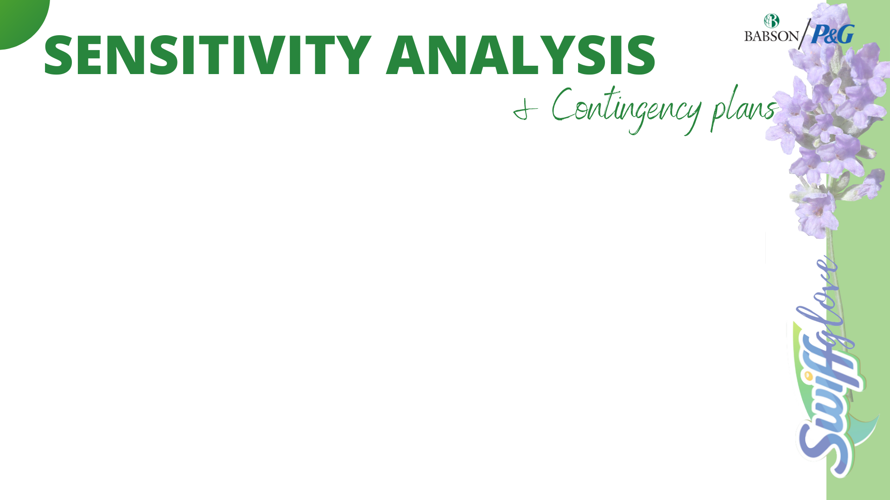
Contingency Plan for the SG&A Expenses
SG&A expenses have been assumed to be 15% of revenues, with no experience curves and cost reductions from scale
Automation of processes to reduce Payroll expenses
Use lean processes to minimize wastage and reduce expenses
Contingency Plan for Proportion of Swiffer Revenues (Y4 & Y5)
Using more effective end-cap displays to attract customers
Using retailer data to identify potential opportunities for growth
Placing the product in both the wipe and gloves store aisles to generate more sales
Promoting the mother brand (Swiffer) to boost our product’s (extension) sales
Contingency Plan for the glove costs
Changing glove material to reduce costs, quotes range from $0.30 to $1.5
Quotes are for pairs of gloves, we plan to sell single gloves, leading to a cost reduction
Volume discounts to be procured

Slide 13
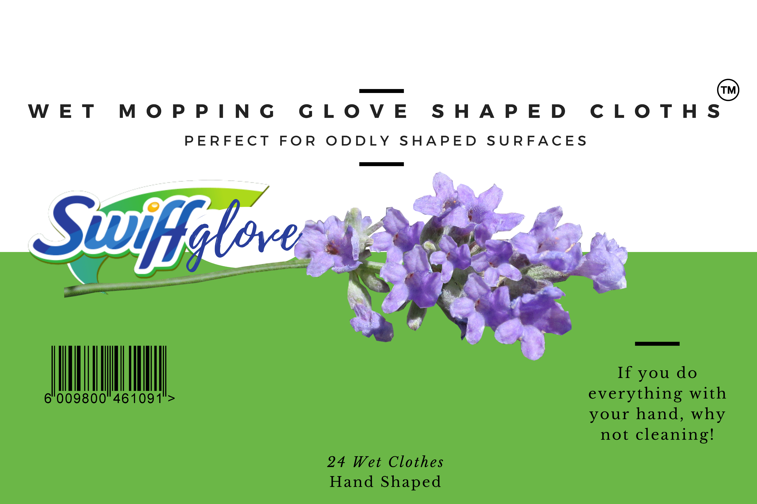
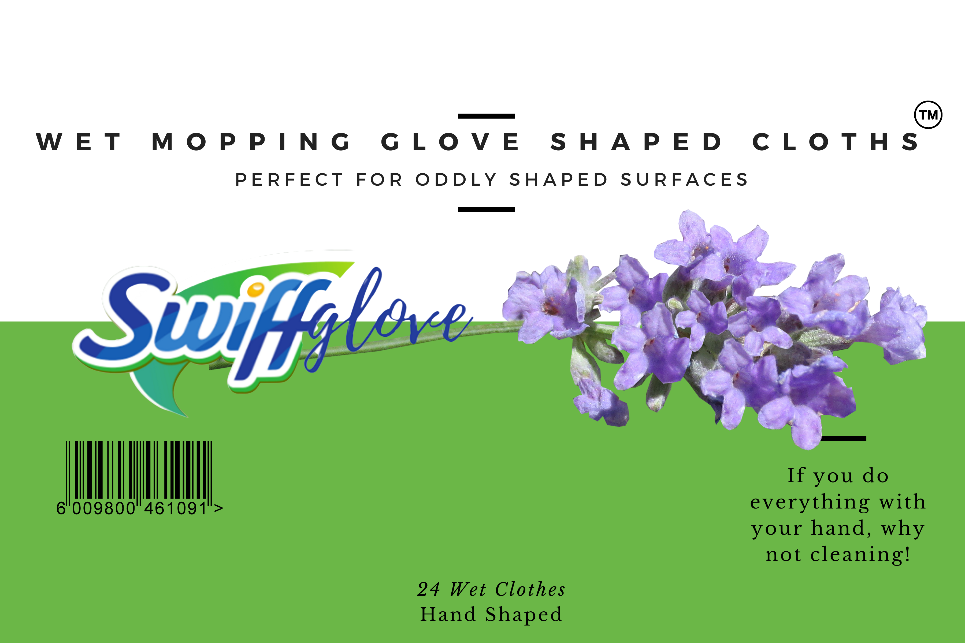
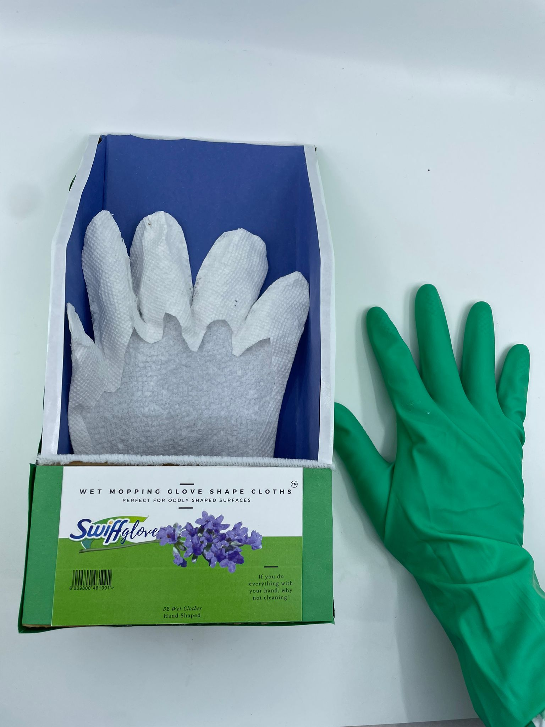

Slide 14

Apendix
Apendix | Slide
Need Articulation | Page 15
Concept Articulation | Page 16
Industry Structure Analysis | Page 17
3 Personas | Page 18, 19 and 20
Initial Feedback of the product | Page 21
Customer Journey Map | Page 22
Price willingness to pay | Page 23
Potential areas of growth | Page 24
Target customer frequency | Page 25
Prototype | Page 26
Operations | Page 27

Slide 15
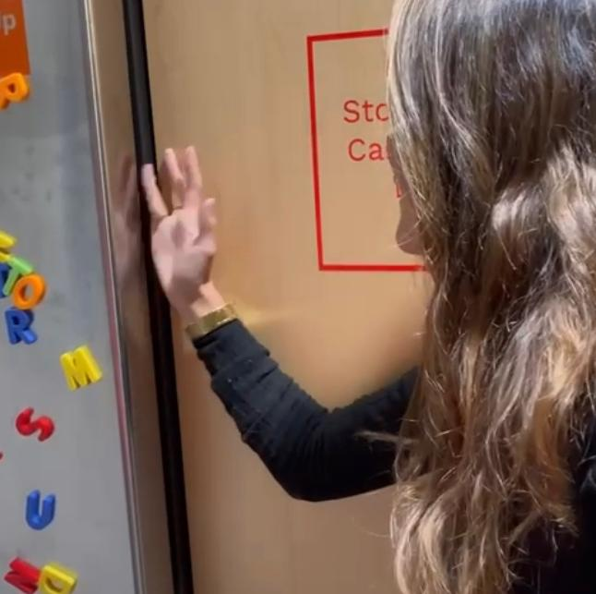
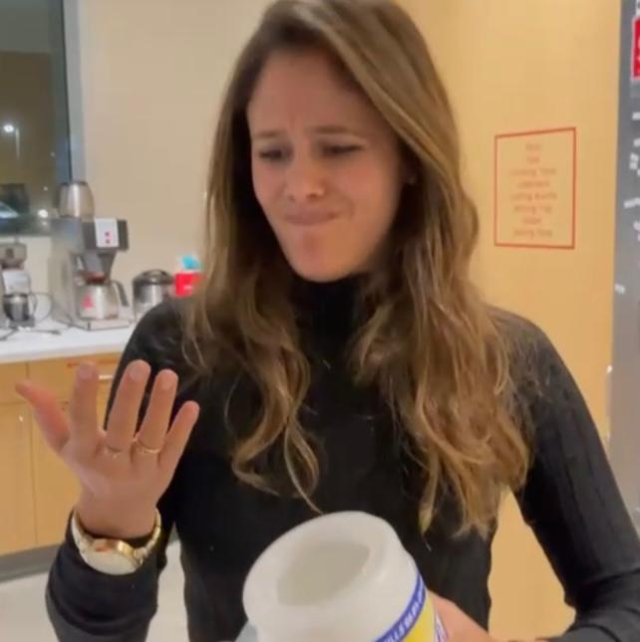




Need Articulation
Pain points
“The Cleaning Conundrum”
“It is hard to clean surfaces like the kitchen cabinets”
A common cleaning problem
“I don´t like the chemicals touching my skin!”
Oddly shaped surfaces
How can we help people clean oddly shaped surfaces while avoiding direct contact with bacteria and cleaning agents?
Unfavorable contact

Slide 16
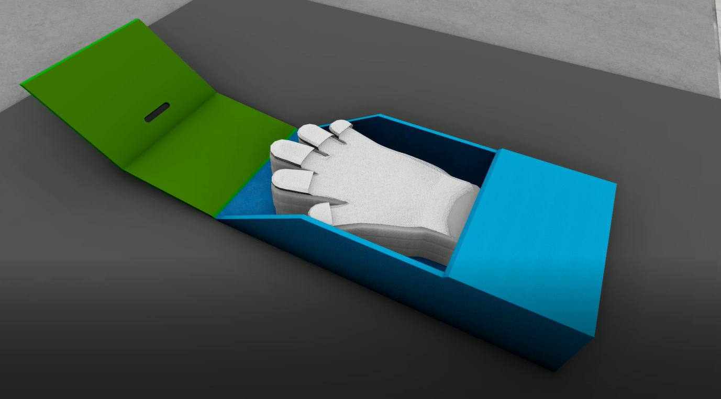
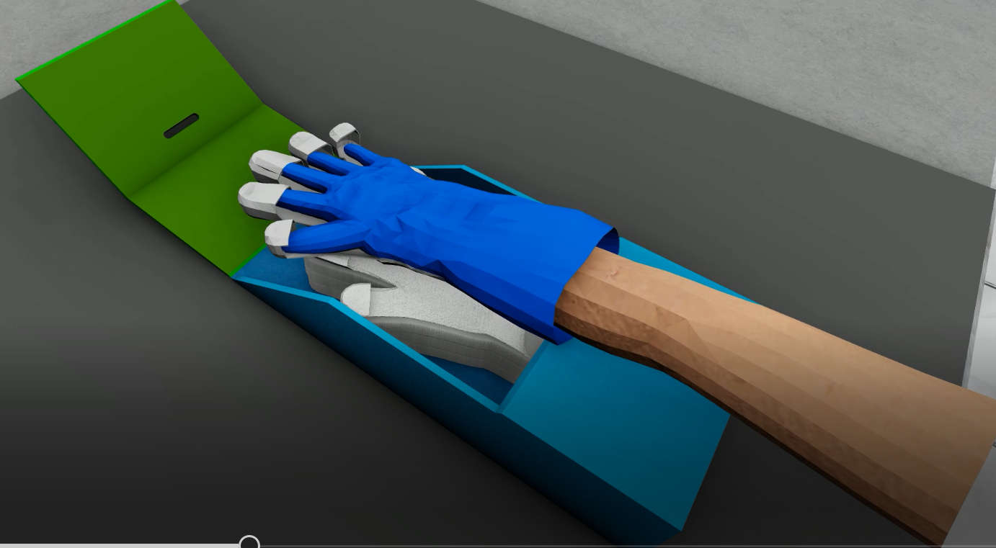
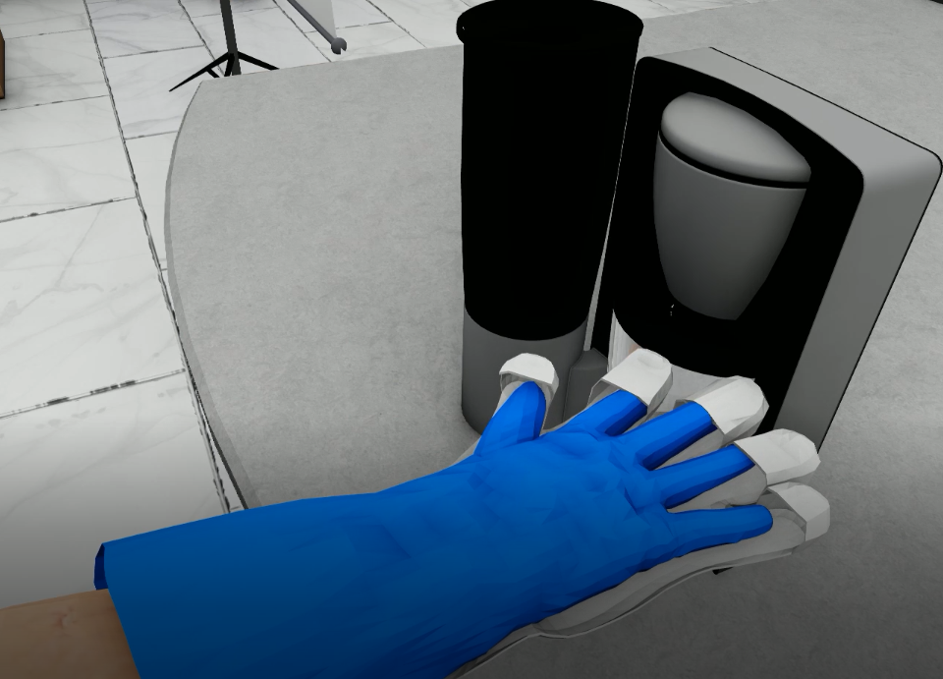
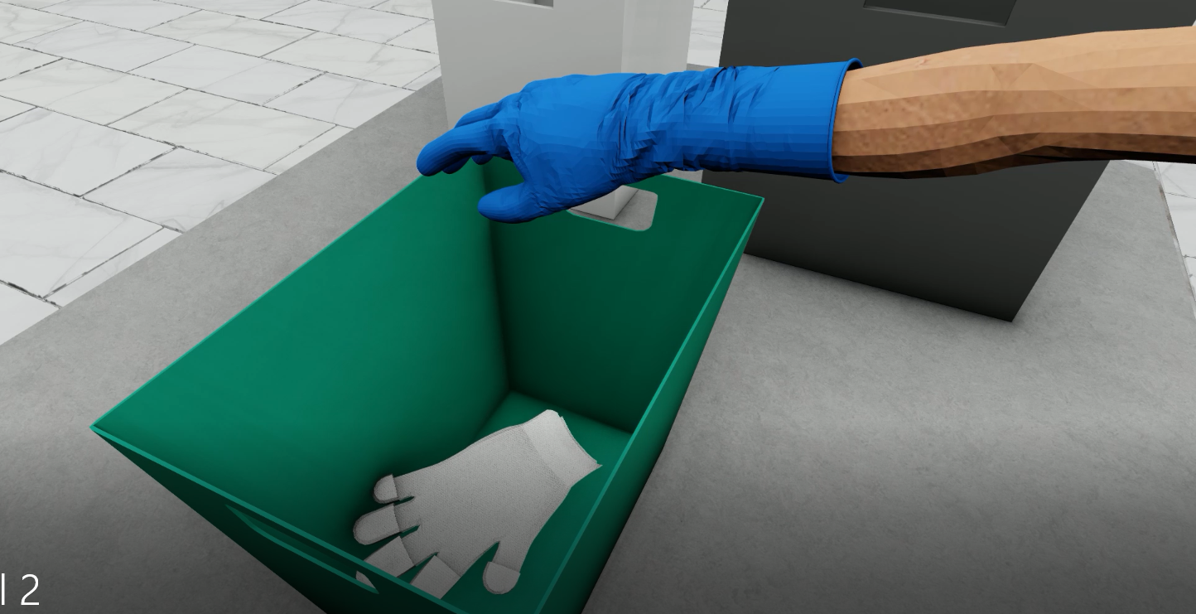
Concept Articulation
1
2
This glove has attachable wipes which stick on and peel off easily, allowing you to intuitively clean oddly shaped surfaces and crevices with your hands.
Put the glove
Place your hand on the wipe
3
4
Clean
Dispose

Slide 17





Industry structure Analysis
Wet/dry wipes Industry
Industry rivalry
MEDIUM
Threat of new entrants:
Aggressive competition for share
Compete not on price but differentiation
LOW
Big players benefit from economies of scale. Difficult for a new player to penetrate
Many players: difficult for a new competitor to find shelf space at the retailers.
Threat of Substitutes
HIGH
Many alternatives available (paper towels, rags)
Established and efficient distribution channels, which reduces operating costs.
Bargaining power of suppliers
LOW
MEDIUM
Bargaining power of buyers:
Many suppliers vs low concentration of industry players.
Chemical / commodity manufacturers: inability to differentiate
product
Larger retailers have more influence because of large purchases
Brand recognition and loyalty from end customers.

Slide 18








Personas
Pascale
Persona 1: Family prioritizing bee
Bio
Quote
Goals
Pain points
Train her children properly
Believes chemical-based cleaning products might be harmful to family
“Stay at home” Mom or dad
Loves her family
Cleans house to protect kids
“I can’t clean between the cabinets with the Swiffer!”
Build unbreakable family bonds
There is no device that clean all oddly shaped surfaces around the house
Prefers chemical based products for bathroom, but gentle products for kitchen
Believes cleaning rags spread germs around surfaces
39
years old
Personality and Interests
Reasons to use and buy this product
Behaviors
Cleaning use
Life stage:
Raising
children
Focused on children’s education
Promotes life values to children
She tends to clean her house 4 or 5 times a week
Makes children clean along with her
Differentiates cleaning by location: Bathrooms, kitchen, living rooms, and bedrooms
Uses a variety of cleaning products, and wipes surfaces with Lysol wipes and paper towels.
Uses:
Broom, Swiffer, Lysol wipes, glass cleaners,
Vacuums and mops
Attracted to product ability to clean oddly shaped surfaces
Sees product as quick and convenient
Attracted to separation product provides
Cost-sensitive and uses products judiciously
15

Slide 19
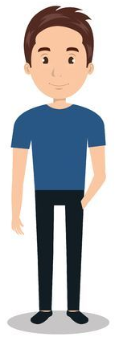
Personas
Christian
Persona 2: Task focused bee
Bio
Quote
Goals
Pain points
The wipes slips in the hands
The wipes slips in the hands
The wipes slips in the hands
The wipes slips in the hands
The wipes slips in the hands
The wipes slips in the hands
“I don’t like touching Lysol wipes with my hands because the chemicals get on my hands”
The wipes slips in the hands
The wipes slips in the hands
Form a family in the future
Earn more money
Needs a one stop shop for cleaning products
Needs a quick solution to cleaning
Does not see value in expensive cleaning products
Prefers an environ-mentally friendly solution
Finish his studies
Needs to save some money
Needs to save money
Needs to save money
Does not spend much time at home
Needs to save money
Needs to save money
Young professional
29
year old
Friendly with environment
Single; lives by himself
Personality and Interests
Behaviors
Cleaning use
Reasons to use and buy this product
Life stage:
Very busy studying and working
Loves Music and hanging out with friends
Tries to clean as fast as possible
Focuses on the living room and bathroom
Loves Sports
Uses
vacuum, Swiffer, wipes and air fresheners
Starts by wiping away dust, then wiping all surfaces with Lysol Wipes
Will protect him from touching unclean surfaces in bathroom
Our product is decently priced
Our product is multi use
Does not clean frequently because he is not home that often
Is not an experienced cleaner; unfamiliar with products
The wipes slips in the hands
The wipes slips in the hands
Intuitive, fast product; not complex or multi step
Needs to save money
16

Slide 20
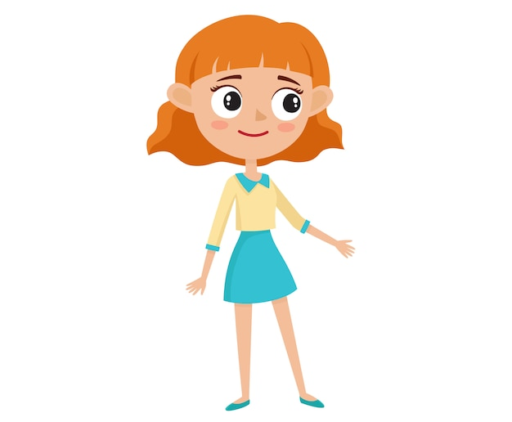
Personas
Lola
Persona 3: Cleaning bee
Bio
Quote
Goals
Pain points
“I feel like it should be easier to clean, I take a long-time cleaning those little spaces between the windows”
Be independent and work hard towards that goal
Extremely dirty surfaces that are hard to reach require better and easier ways to clean
She wishes she could use products that disinfect with chemicals, but the place where she works prefer natural products
Needs the place to be clean
There are many cleaning products but non are all purpose
45
years old
Perfectionist
Personality and Interests
Reasons to use and buy this product
Behaviors
Cleaning use
Likes to watch TV in her free time
As a professional she does not buy her own products
To clean small surfaces, she uses a wipes but can not clean small places
She usually uses many products to clean
Uses Swiffer, paper towels, disinfectant, wipes, Lysol and a broom plus a mop
Our product will help her clean all surfaces
Our product will help her perform her job faster
Our product will be easy to use and intuitive
She has a defined cleaning routine
Due to constant cleaning, she must protect hands with gloves
17

Slide 21

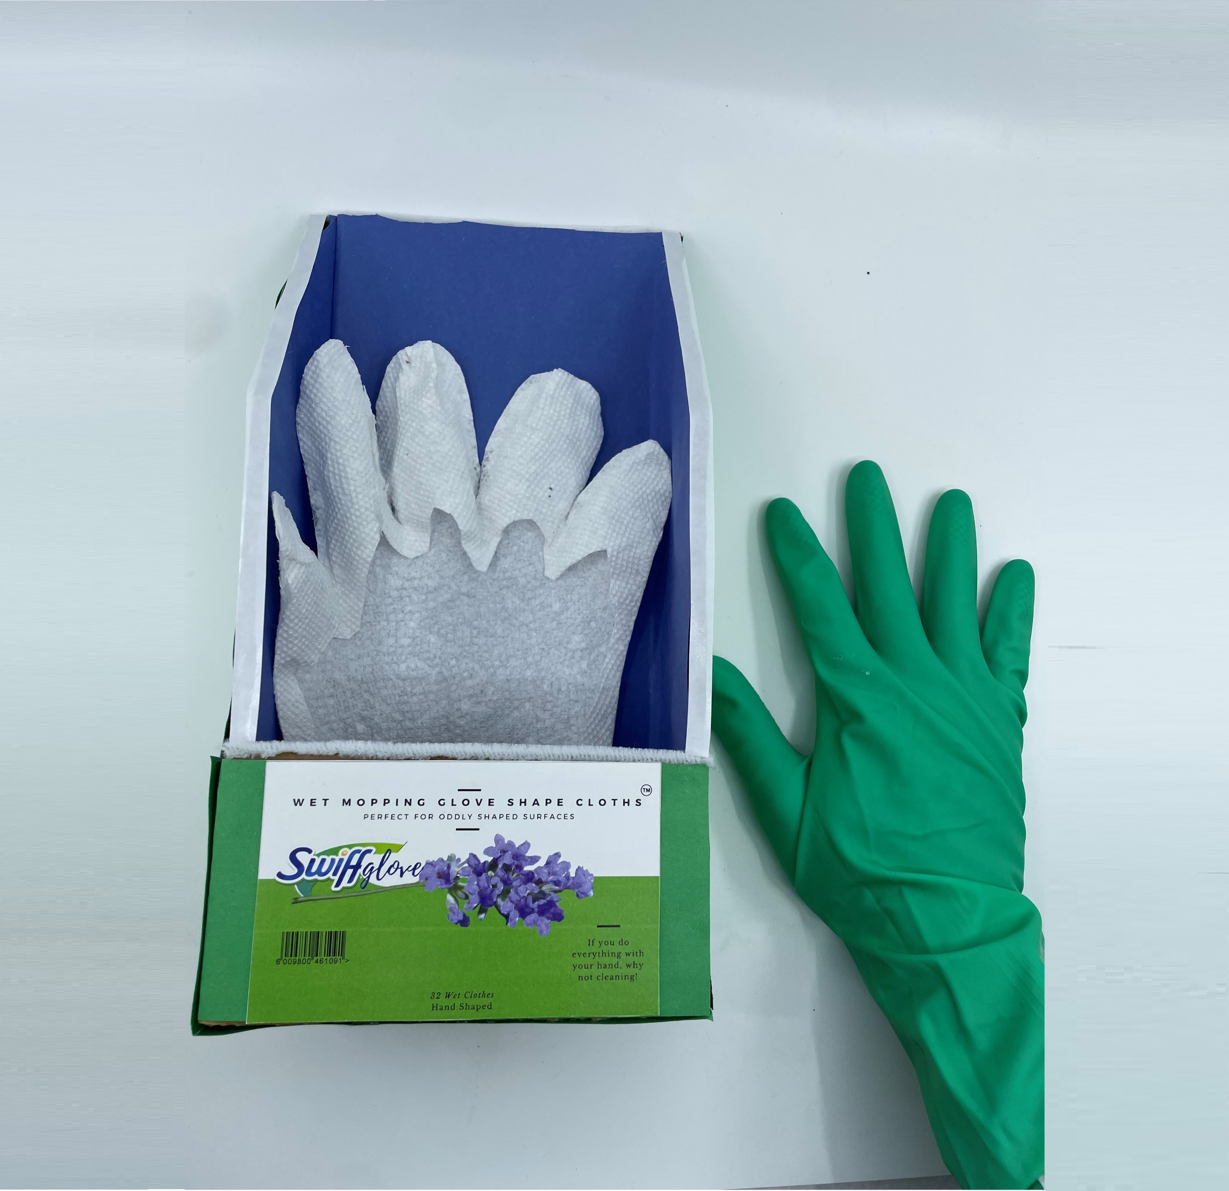
Initial feedback of product
Person 1
“Less trash! I would waste less with this option, the paper is smaller, and you get to reuse the main glove”
“I love that it sticks, it is perfect for the dust in small areas”
Person 2
“I feel this option is more resistant to any liquid, the liquid does not get through easily”
Person 3
“It would help me to reach gaps with my fingers between the stove, refrigerator, etc., I would buy it”
Person 4
18

Slide 22










Customer Journey Map for the “Family prioritizing bee
“Research and Shopping time!”
“I’ve found it!, It’s so simple!”
“So difficult!”
“This isn’t going to work!”
Oddly-shaped surface cleaned!
The customer’s needs to clean the kitchen cabinets but it is so hard!
The customer attempts to clean the oddly shaped surface with a crumbled-up paper towel. Can not reach all the area and gets wet with the product, fails completely!
The customer resolves to find a solution for these types of problems once and for all. But does a product for something like this even exist?
The customer finds the perfect product – Their own hand! It’s niche, unproven, yet possibly the most convenient product yet.
19

Slide 23
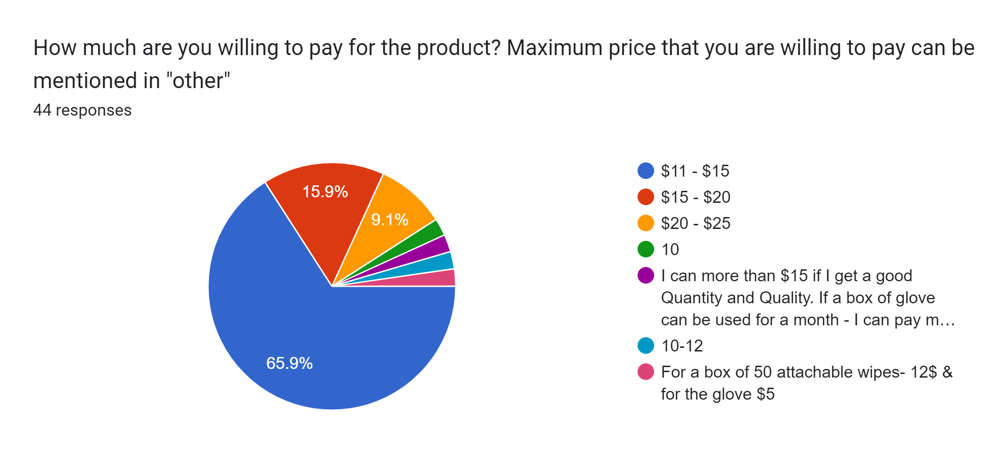
Price Willingness to pay
20

Slide 24
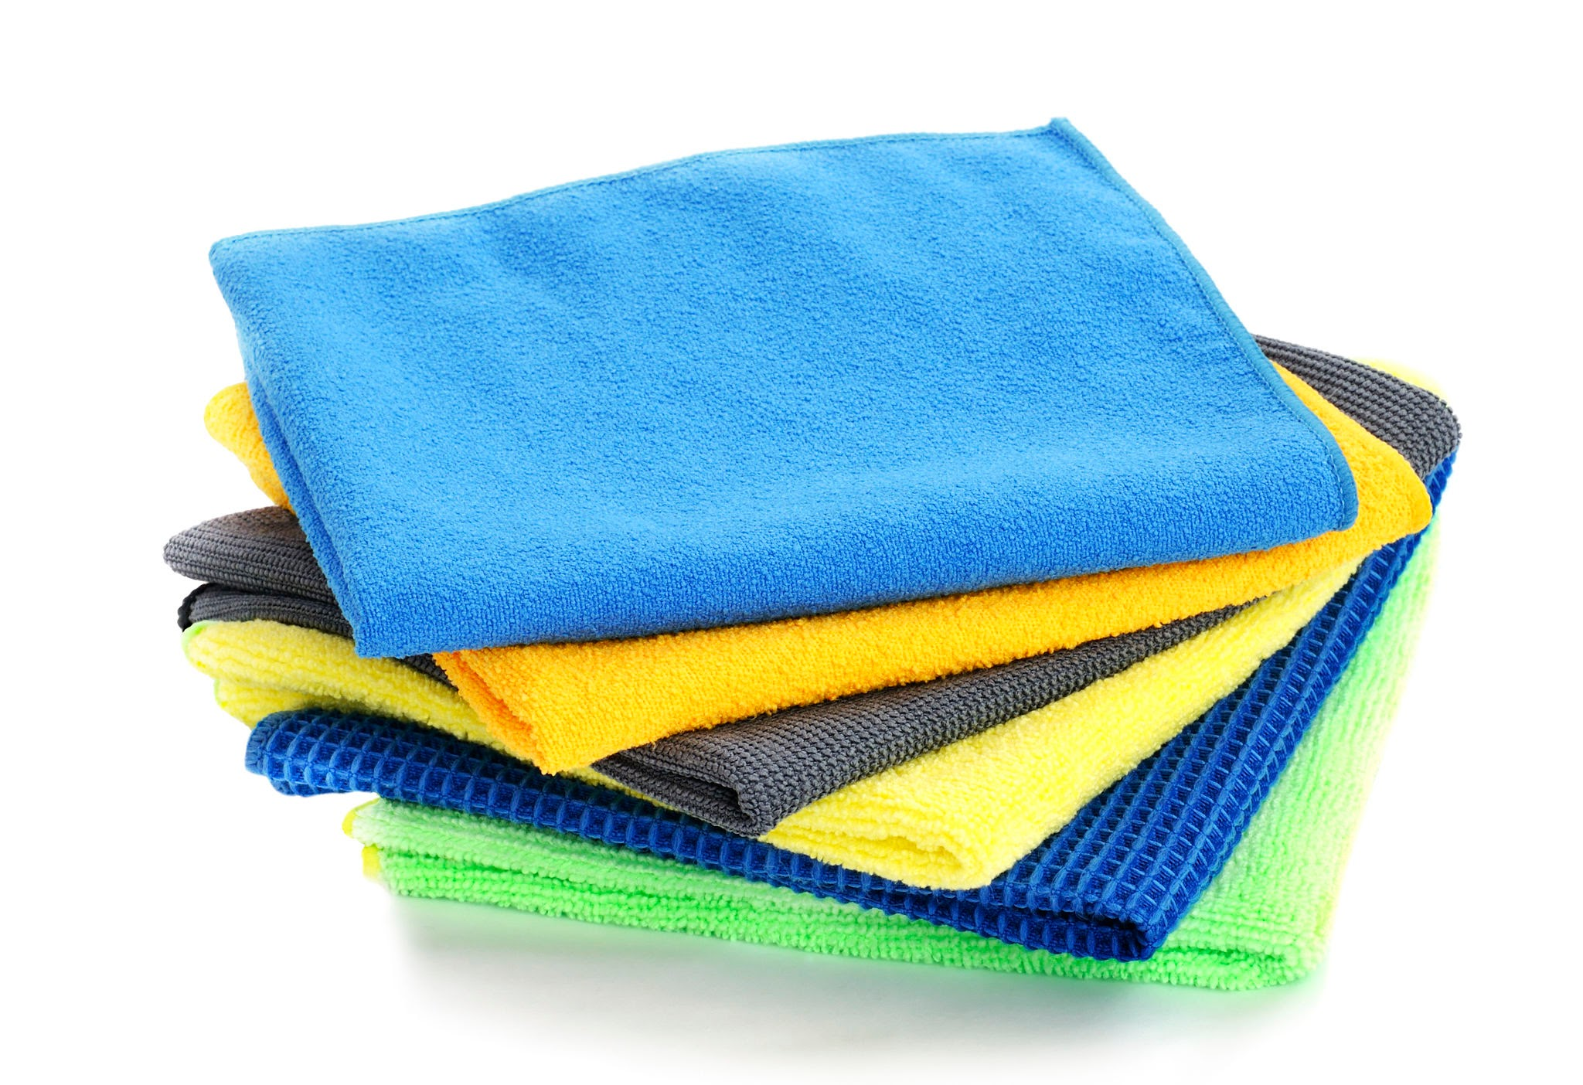
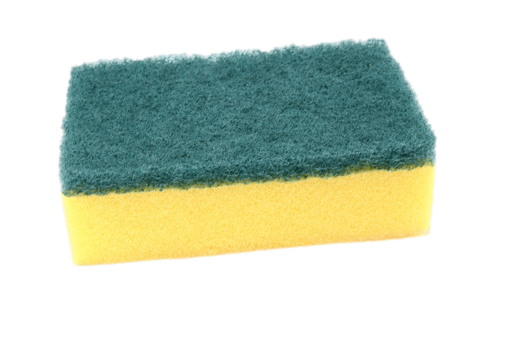
Potential area of growth
Additional add ons
Other types of products can be sticked in the glove: yellow sponge for washing dishes, microfiber cloths
Advantages
Glove in all the house
This product will be part of all the cleaning “to do” at home
Protect from chemicals and bacteria
Now with detergents, grease disinfectants, etc.
Clean odd surfaces
Everywhere!
21

Slide 25
Target customer frequency
*Considering 6 units used per cleaning (1 per week) the customer would use 24 units per month
24

Slide 26
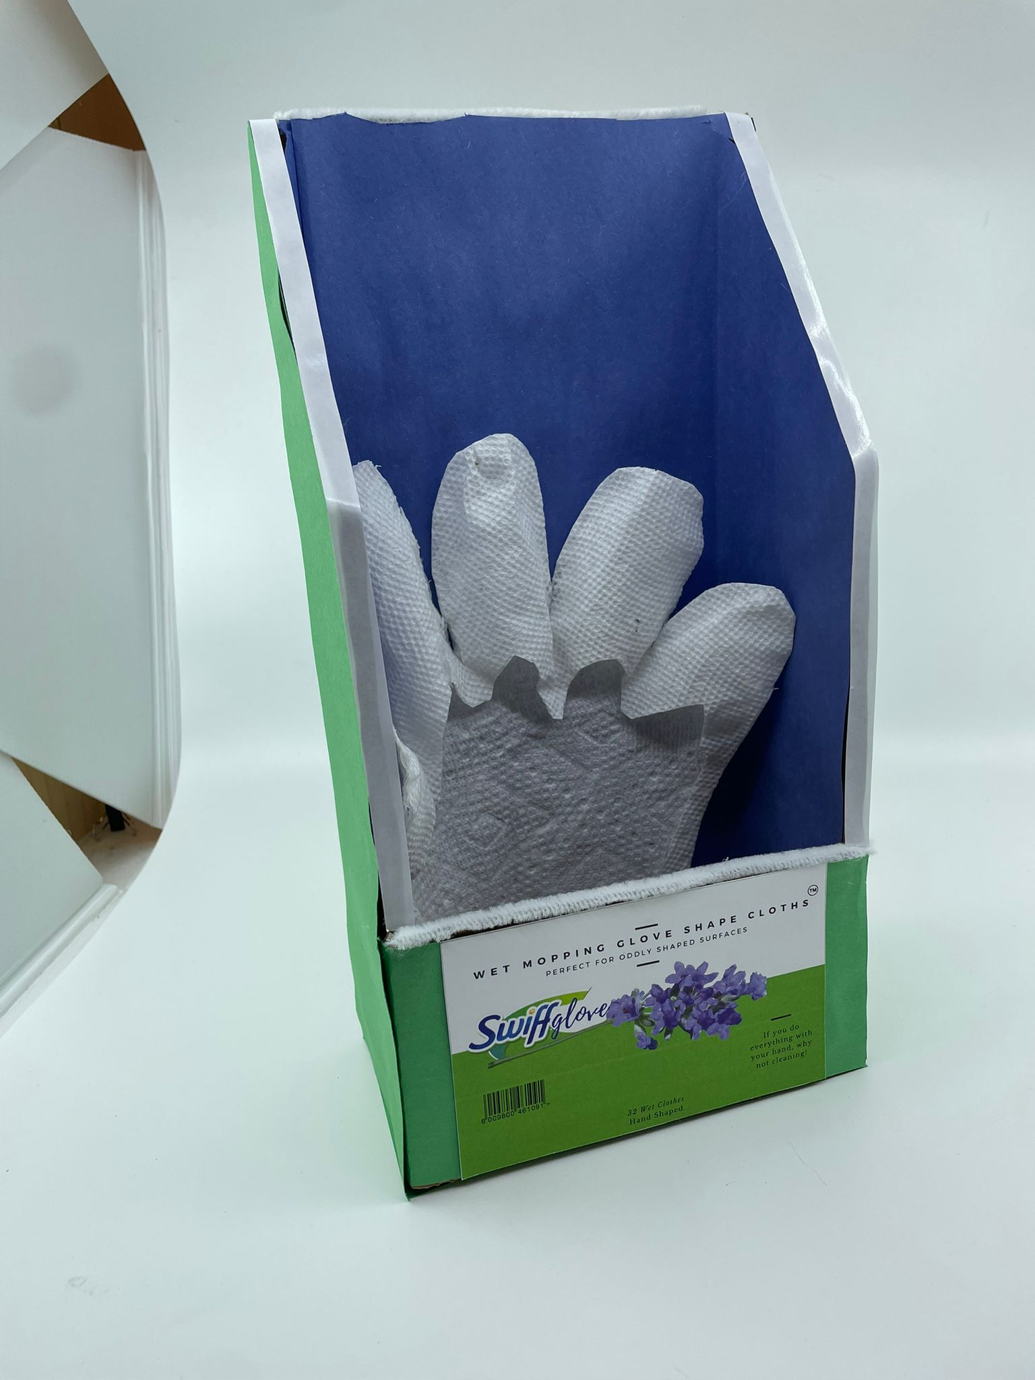
Prototype
25

Slide 27
Operations
25

Slide 28
Excel File
https://drive.google.com/drive/folders/12DKiZjZOwDae4th-QG75S7wk6SkPqpMR?usp=sharing
25

